Slide 1
Sprint Review 2
Importing Excel Data into SQLite Studio Database/Tables

Slide 2
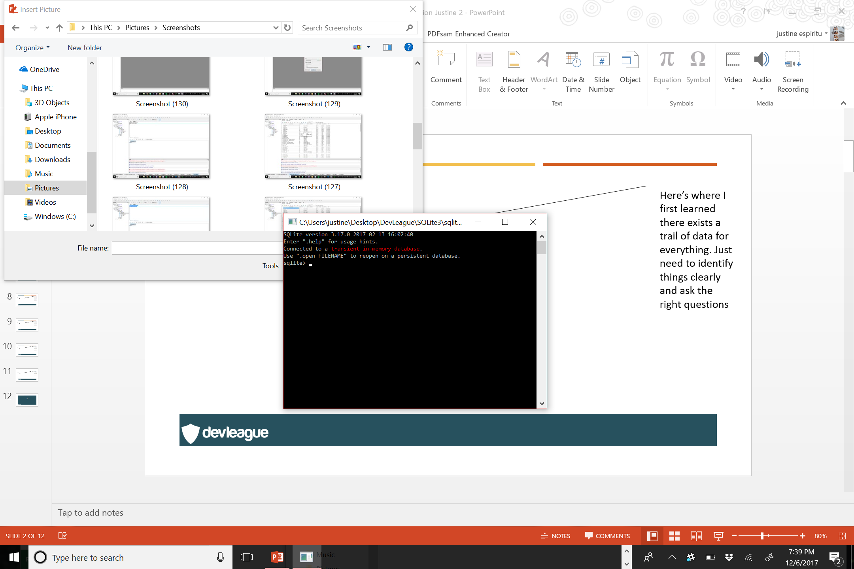
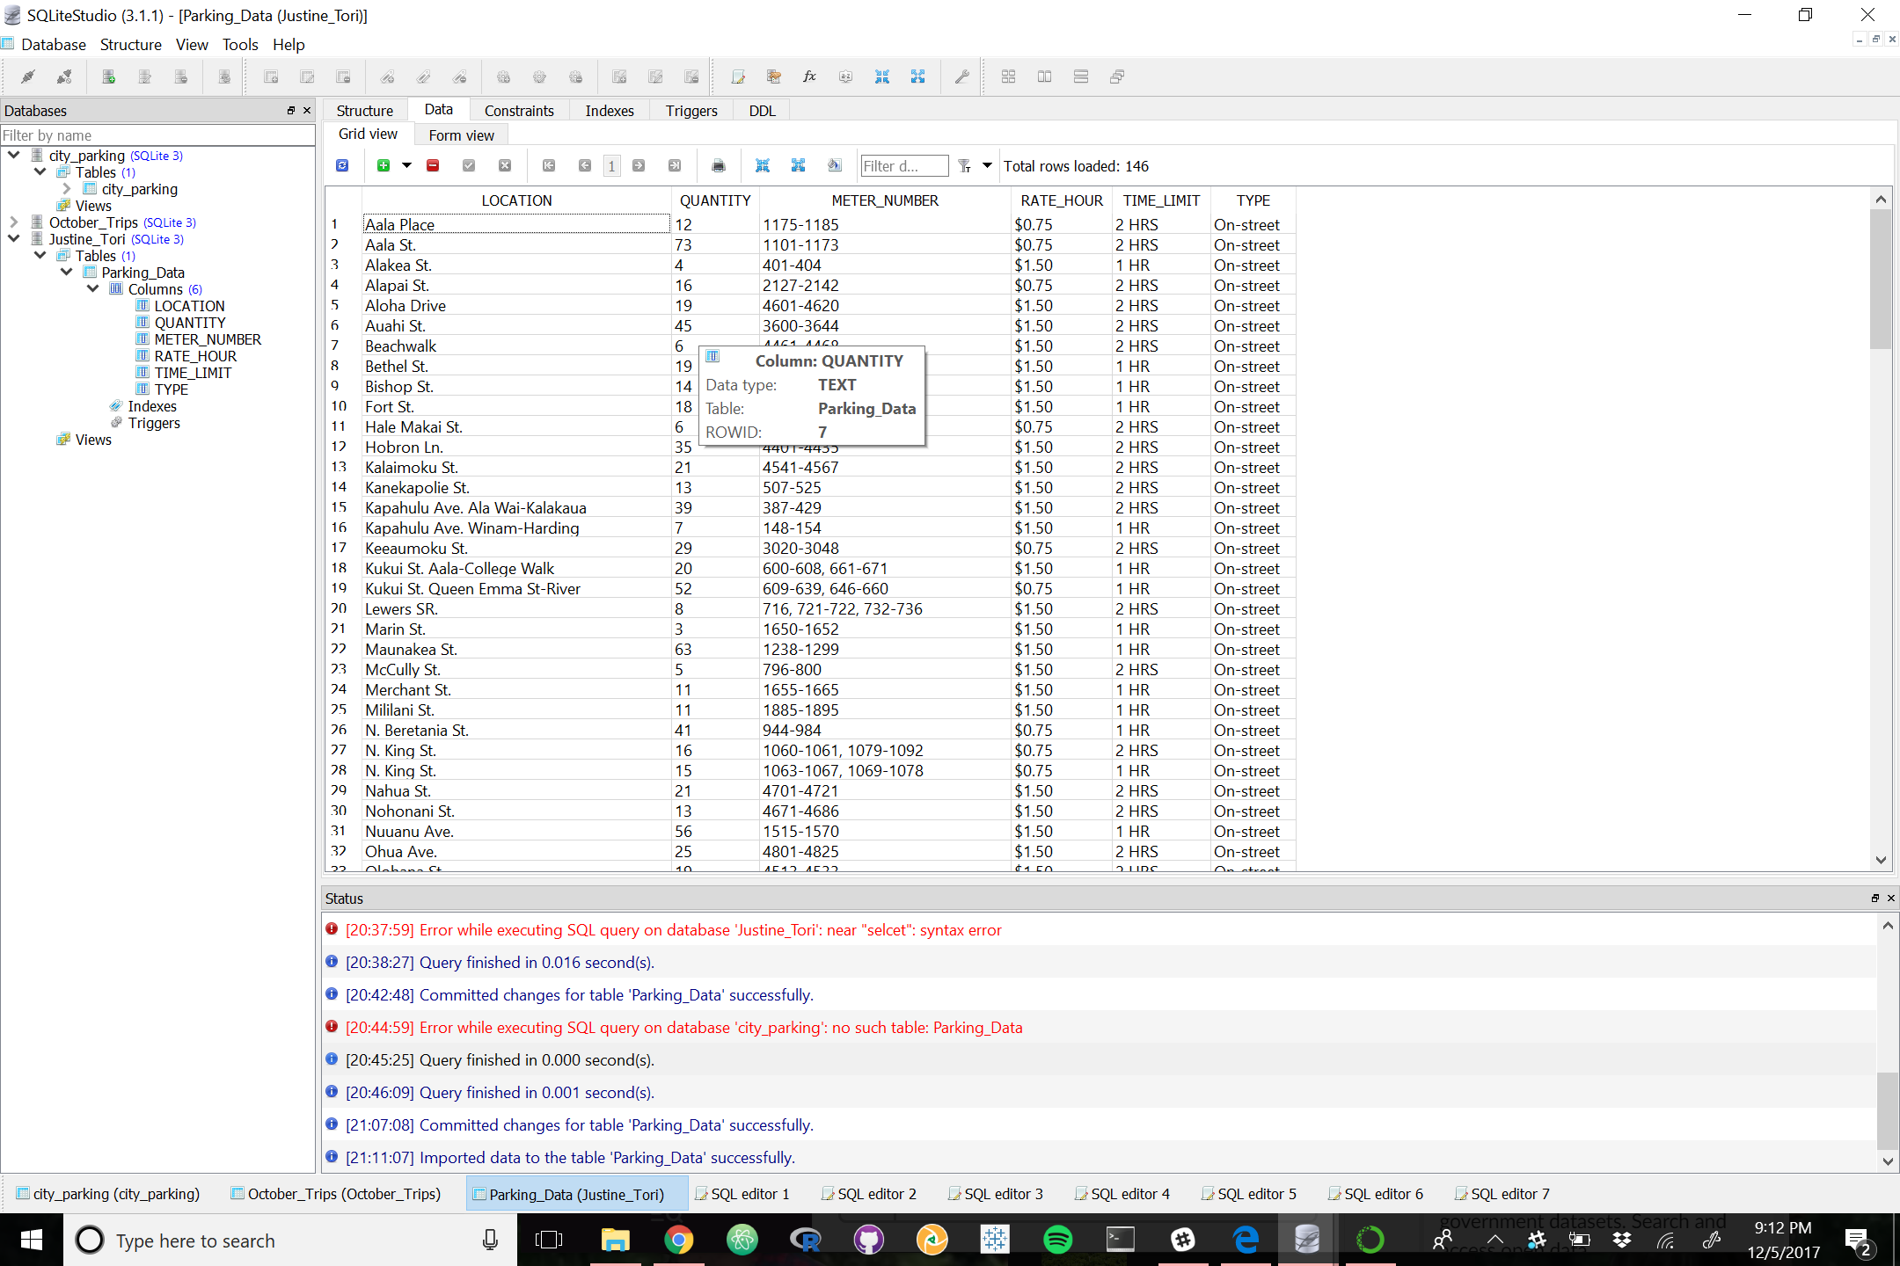
SQLite3 Command Line

Slide 18
Fin

